Slide 1

Adidas SWOT Analysis

Slide 2
ADIDAS
Company: Adidas Group Founder: Adolf (Adi) Dassler Year founded: 1924 (as Gebruder Dassler Schuhfabrik), 1949 (as Adidas) CEO: Kasper Bo Rorsted Headquarter: Herzogenaurach, Bavaria, Germany Type: Public Ticker Symbol: ADDYY Market Cap (May 2020): $44.9 Billion Annual Revenue (FY 2019): $25 Billion Profit |Net income (FY 2019): $1.5 Billion

Slide 3
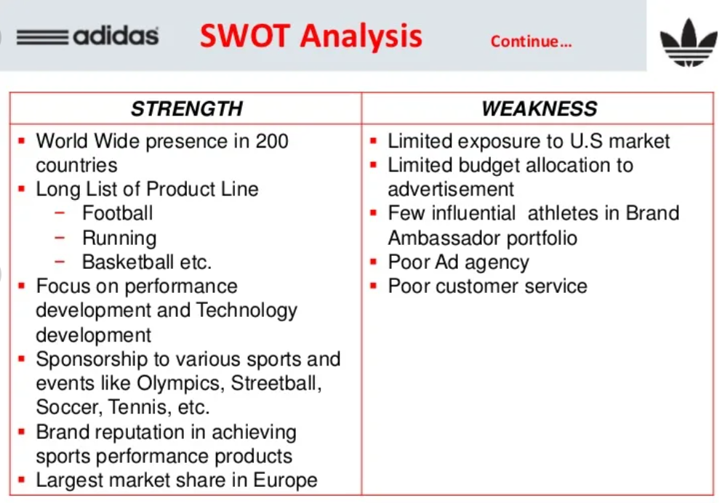

Slide 4
